Slide 1
Dowling Lab
End of Semester Presentation
Joe Jackson
Notes:
Brief introduction:

Slide 2
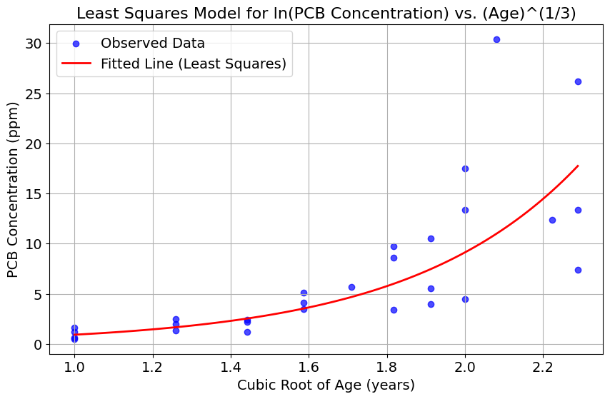
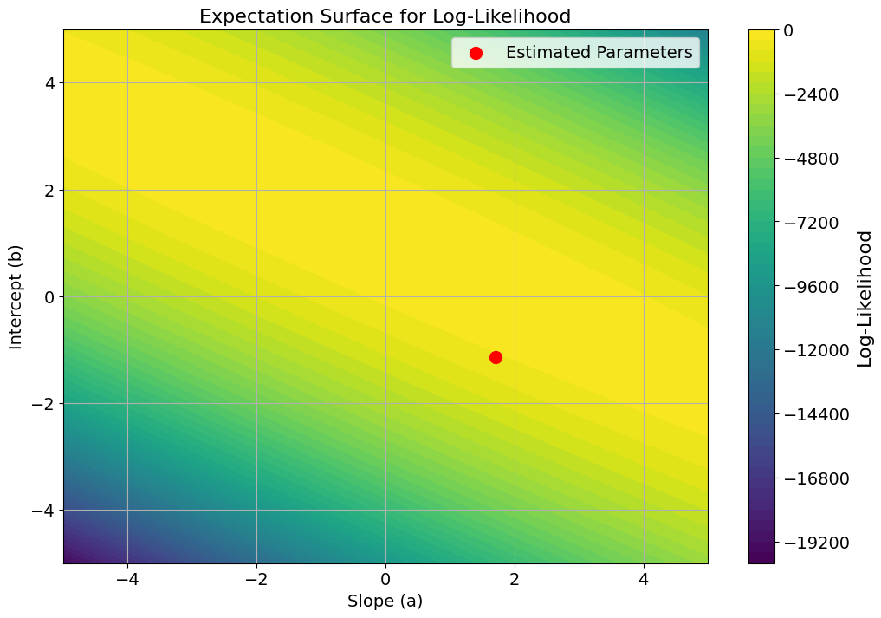
Pyomo Reproduces Bates & Watts PCB Parameters
Notes:
Thought it would be of value to run through this simpler example and do a lot of the calculations by hand (with python) and then compare to what IPOPT gives.
Pyomo and ipopt by hand -> Parmest Minimizing the squared error, comparing which model is better using the objective values,

Slide 3
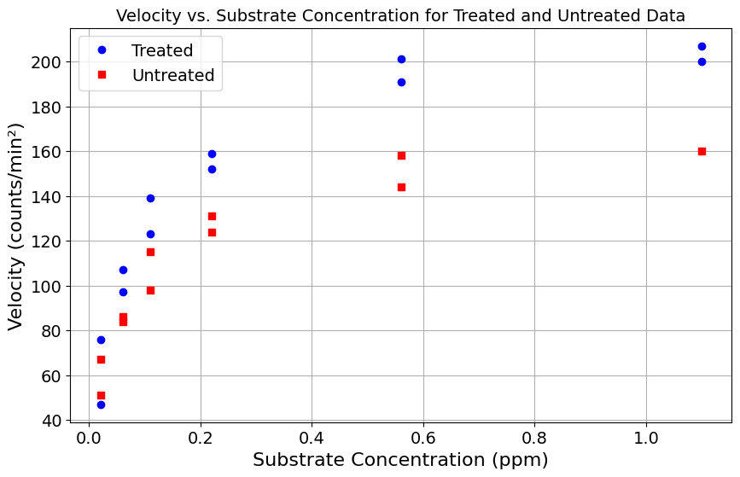
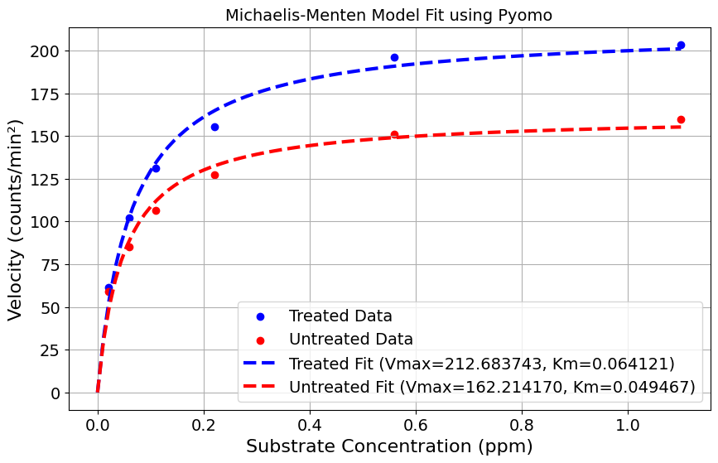
Parmest Reproduces Kinetic Parameters from Puromycin in Bates & Watts
Notes:
Take what I had learned and apply it to a new model

Slide 4
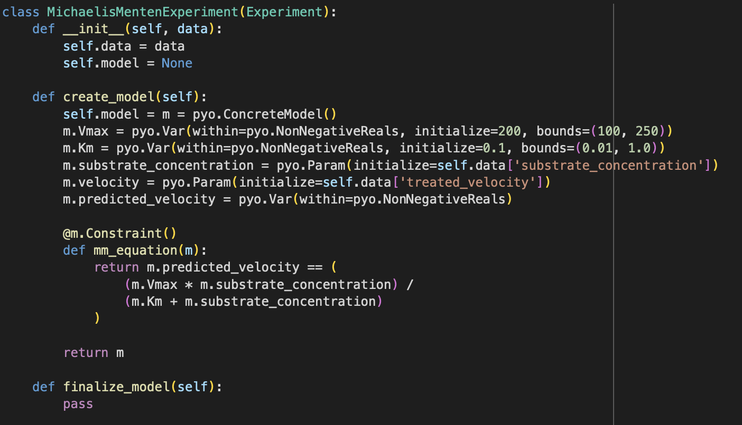
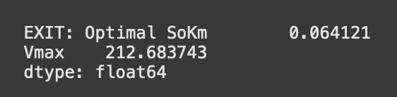
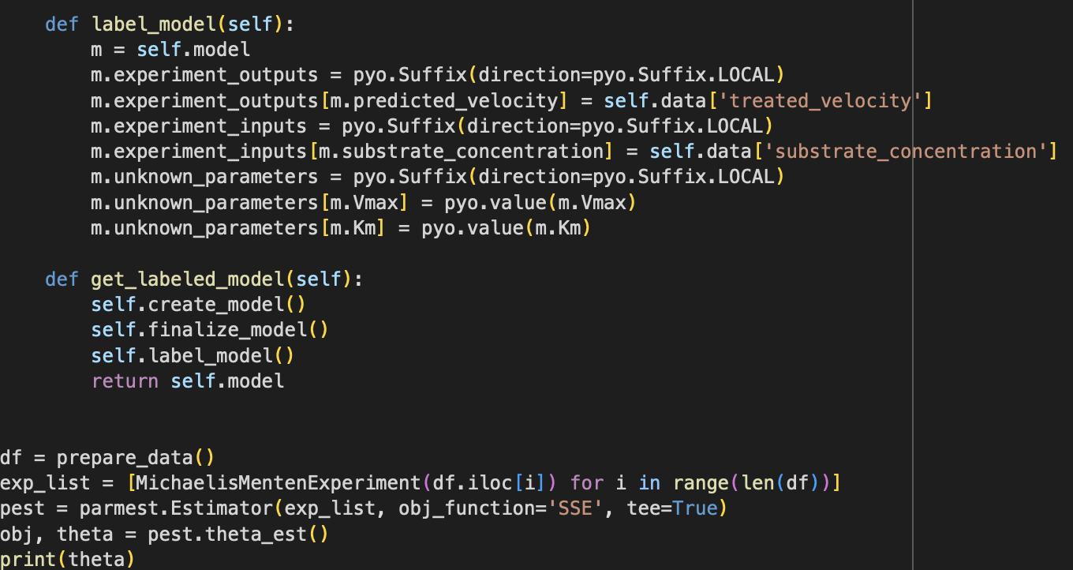
Continued
Notes:
Switching to the Experiment Class to be able to add repeatibility, useful for

Slide 5
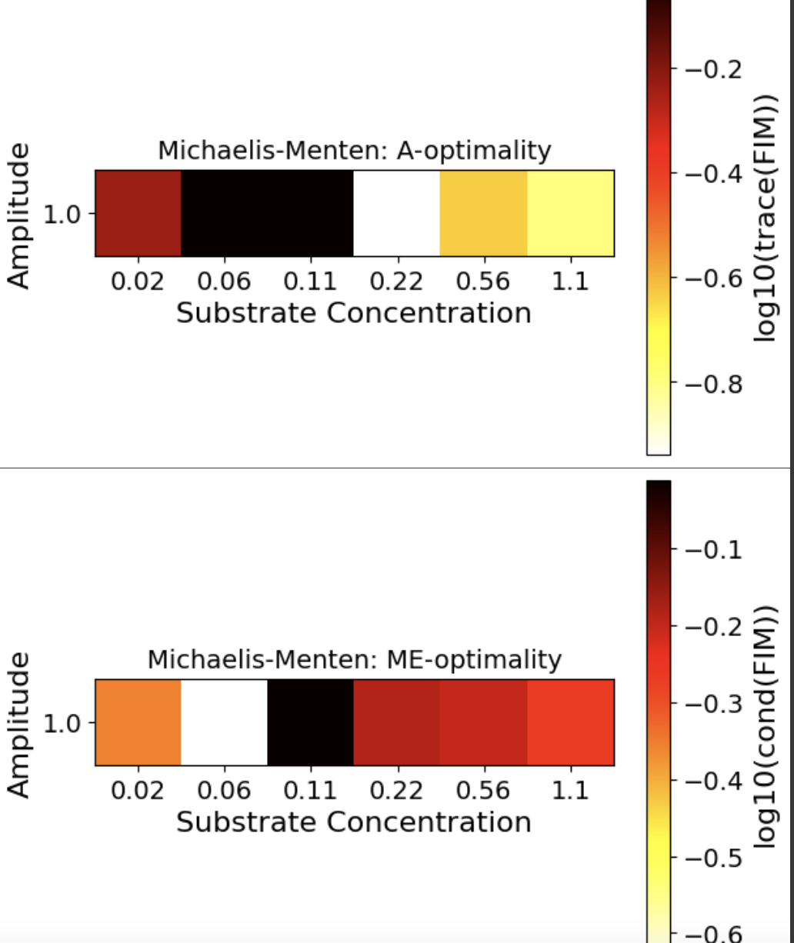
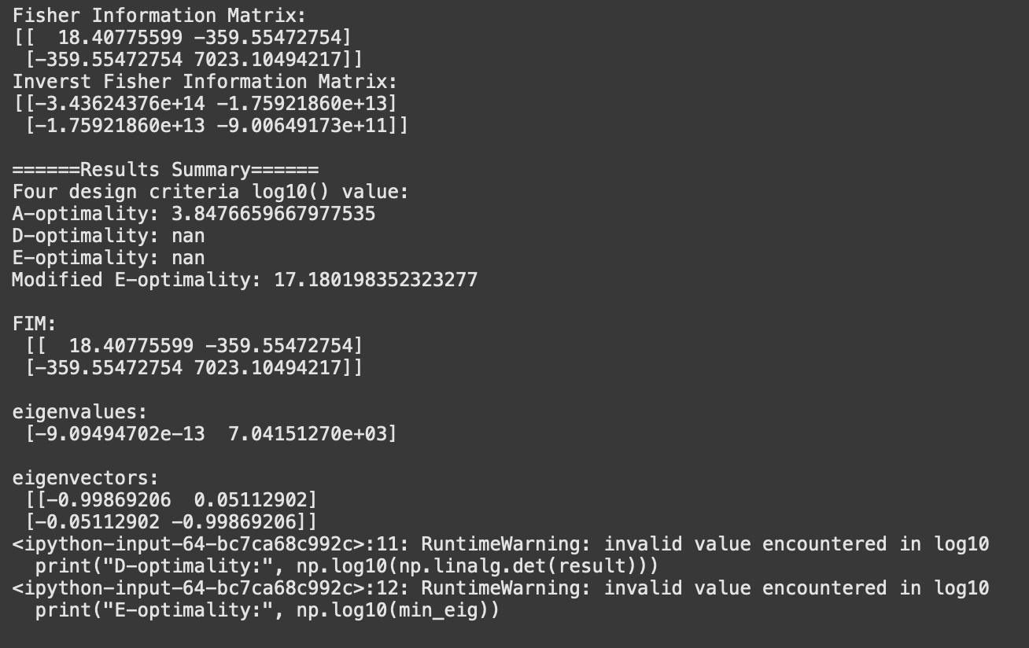
Exploratory Analysis of Puromycin Yields Interesting Fisher Information Matrix
Notes:
Getting a geometric interpretation of these results
What it tells us and what the next steps
Geometric interpretation is that the ellipsoid that the parameters should fall in is very small in the direction of

Slide 6
Conclusion
Thank you to Stephen and Dan!
Notes:
Learned a lot this semester even with one credit

